Slide 1
Reproduction
&
Sexual health
Sexuality, Health and Responsibility Education
7th Grade
Notes:
Are your classroom colors different than what you see in this template? That’s OK! Click on Design -> Variants (the down arrow) -> Pick the color scheme that works for you!
Feel free to change any “You will…” and “I will…” statements to ensure they align with your classroom procedures and rules!

Slide 2

Sex Education for Middle School-Body Basics

Slide 3
What do you think you know?
Sexual intercourse is when…
A pregnancy can start when…
A pregnancy can’t start when…

Slide 4
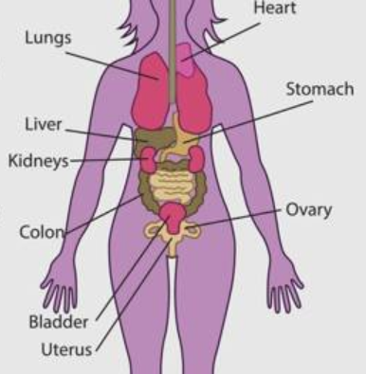
Location of Reproductive System
A biological female’s uterus is located in the abdominal cavity, BUT it is not the same thing or close to the stomach.

Slide 5
Average Menstrual Cycle
Menstrual periods usually begin between the ages of 9-15.
Average menstrual cycle is about 28 days but varies widely between individuals.
  Can occur anywhere from 21-35 days.

Slide 6
Average Menstrual Cycle
It’s quite common to be irregular for the first few years of menstruation.
Periods can be affected by stress, diet, exercise, etc.

Slide 7


Do not hesitate to ask…
If you are concerned or have questions about your menstrual cycle
  Talk to a trusted adult
  Talk to your health care provider
  What to expect when you talk to your health care provider:
  You do not have to have a physical exam (pap smear or vaginal exam) to discuss your concerns.

Slide 8
An ovum (egg) is released from the ovary into the fallopian tube on a monthly basis.

Slide 9
If the ovum unites with a sperm and implants in the uterus a pregnancy can begin.
Fertilization

Slide 10

YOU CAN BECOME PREGNANT
BEFORE YOU’VE HAD YOUR
FIRST PERIOD
Because you ovulate BEFORE you menstruate.

Slide 11
If the egg does not unite with a sperm within 24-48 hours, it will dissolve and be reabsorbed by the body.

Slide 12
To prepare for a potential pregnancy, each month the uterus grows a thick lining to create a good environment for the potential fetus. That is what a baby is called before it’s born.

Slide 13
If the egg and sperm do not unite, hormones signal the uterus to prepare to shed the lining causing someone to menstruate or have “a period”.

Slide 14
Menstruation, or having “a period” is when the uterus rids itself of the lining because there was no fertilized egg.

Slide 15

Types of Contraception
PROTECTS RIGHT NOW
Abstinence- 100% effective
External condoms *
Internal condoms *
Withdrawal-least effective
Emergency contraception *
Dual Use
PROTECTS FOR A MONTH
Pills/Patch/Ring
Dual Use
PROTECTS FOR A FEW YEARS
IUDs/Shot/Implant
Dual Use
* Over the Counter
Dual Use: a condom is also used.
Internal and External condoms CANNOT be used together!
https://kidshealth.org/en/teens/bc-chart.html

Slide 16

“CONSISTENTLY AND CORRECTLY”
Used Every Time without fail!
Used as directed!
  Yes, read the directions on the package!
  If you have questions,
    Talk to your health care provider or
    Trusted adult.
Condoms can only be used ONE TIME

Slide 17

Reproduction Basics
28 Day Cycle Activity

Slide 18
Remember
No matter how you identify, It’s important for everyone to understand how the biological female’s reproductive system works. To understand what’s normal and, in some cases, when to see a health care provider.

Slide 19

Human Journey in the Womb

